Slide 1
MORPHOBOT
TERM PROJECT
TEAM-9
Presented By:
Harshavardhan Vibhandik
Dinesh Sai Rallapalli
Satya Krishna Kotla
Sanket Patil
Guided by: Professor Vikram Kapila

Slide 2
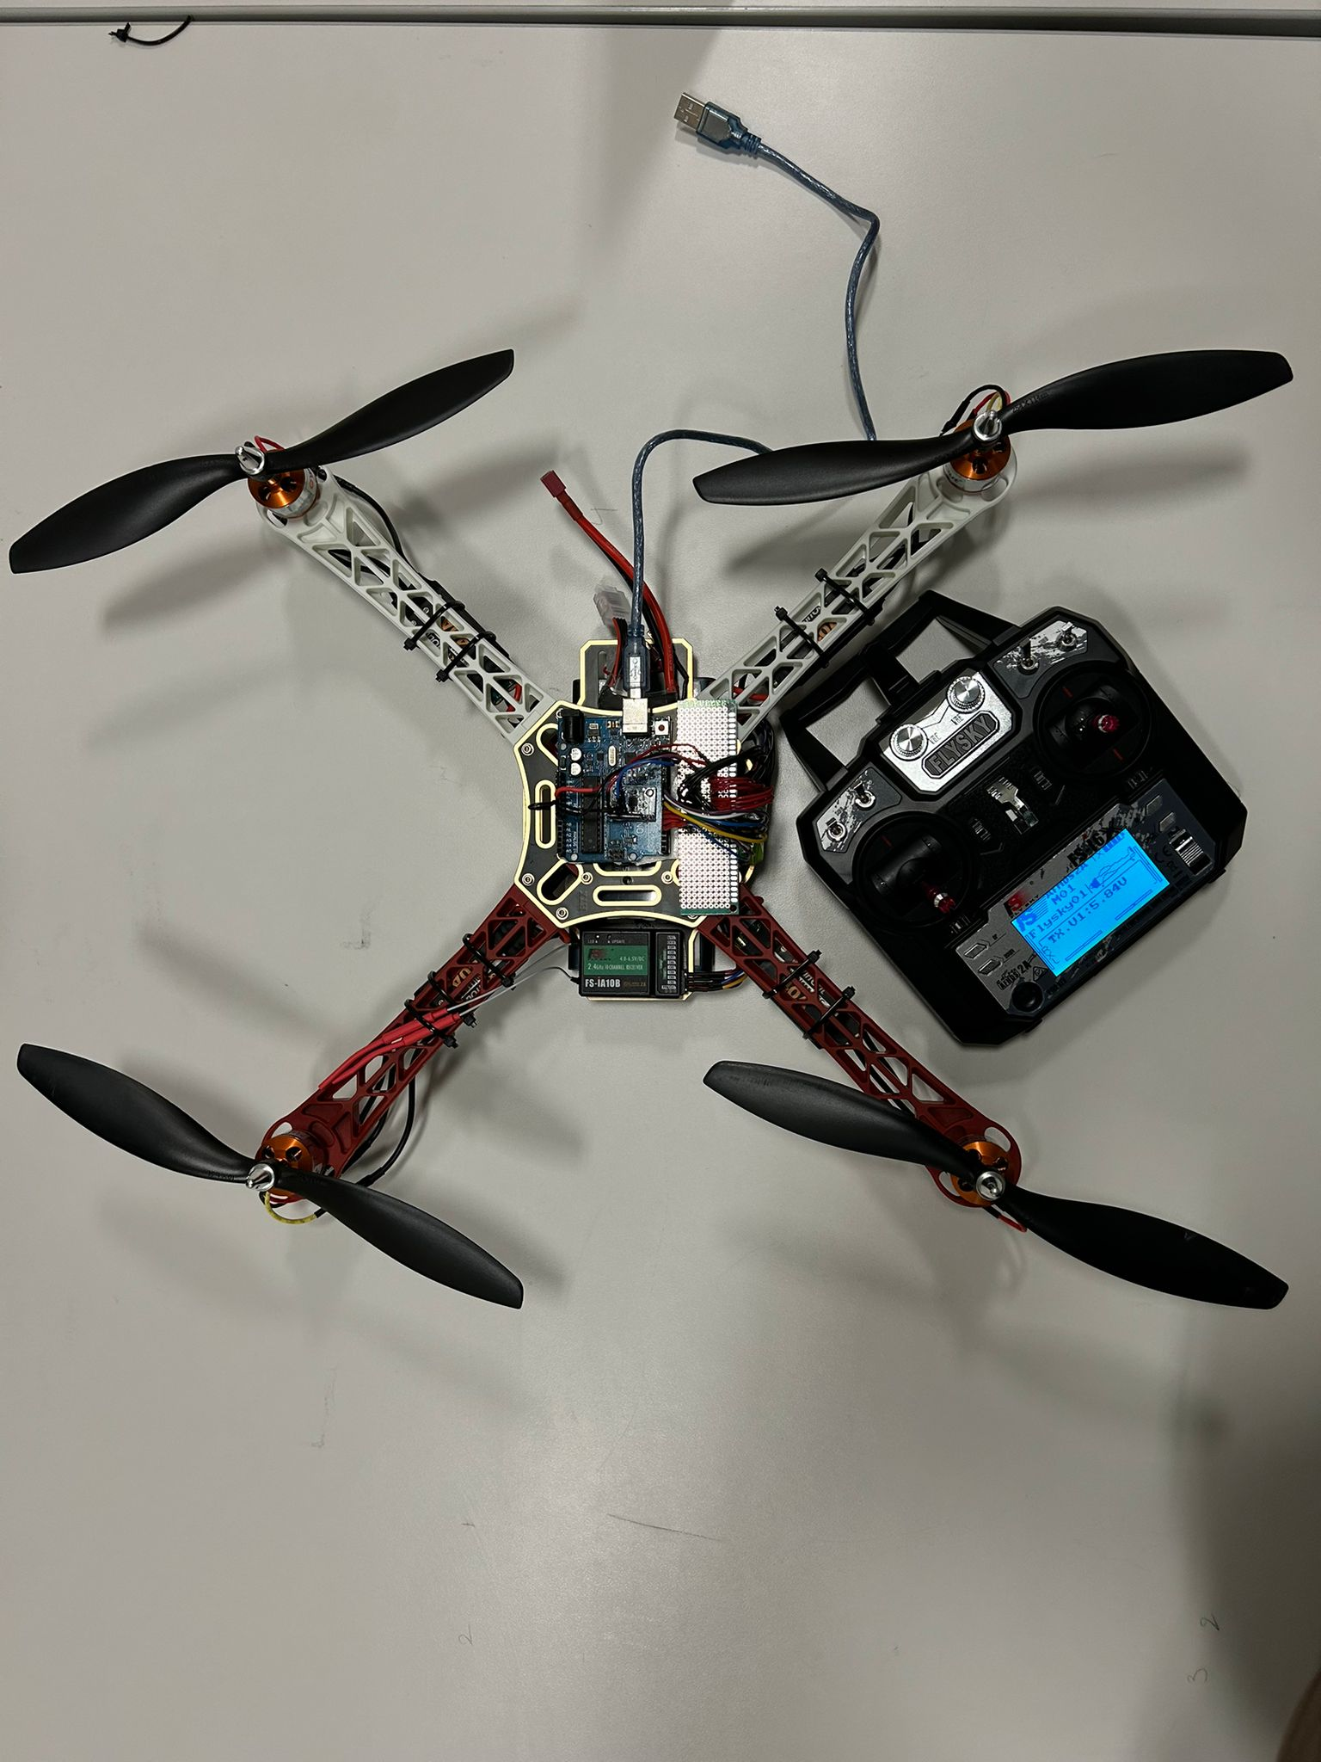
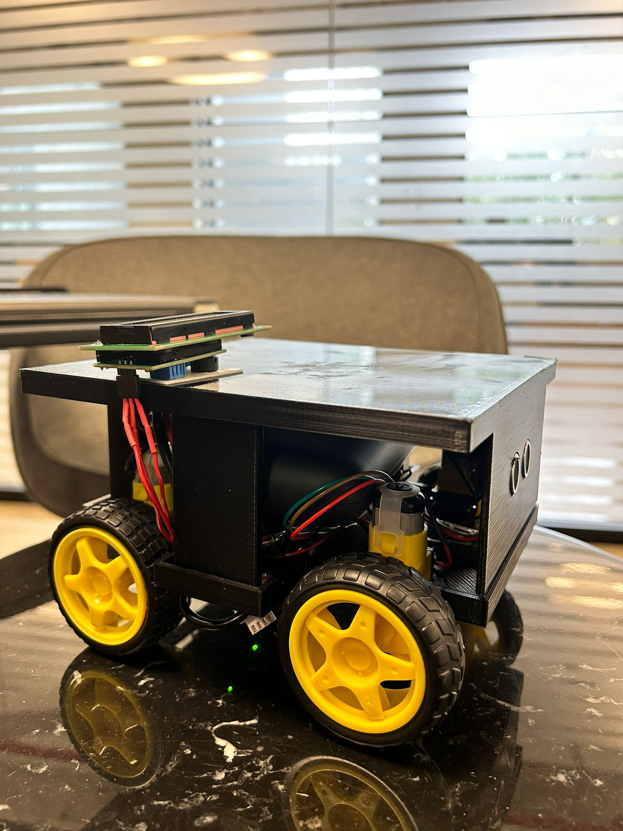
PHASE-I
PHASE-II

Slide 3
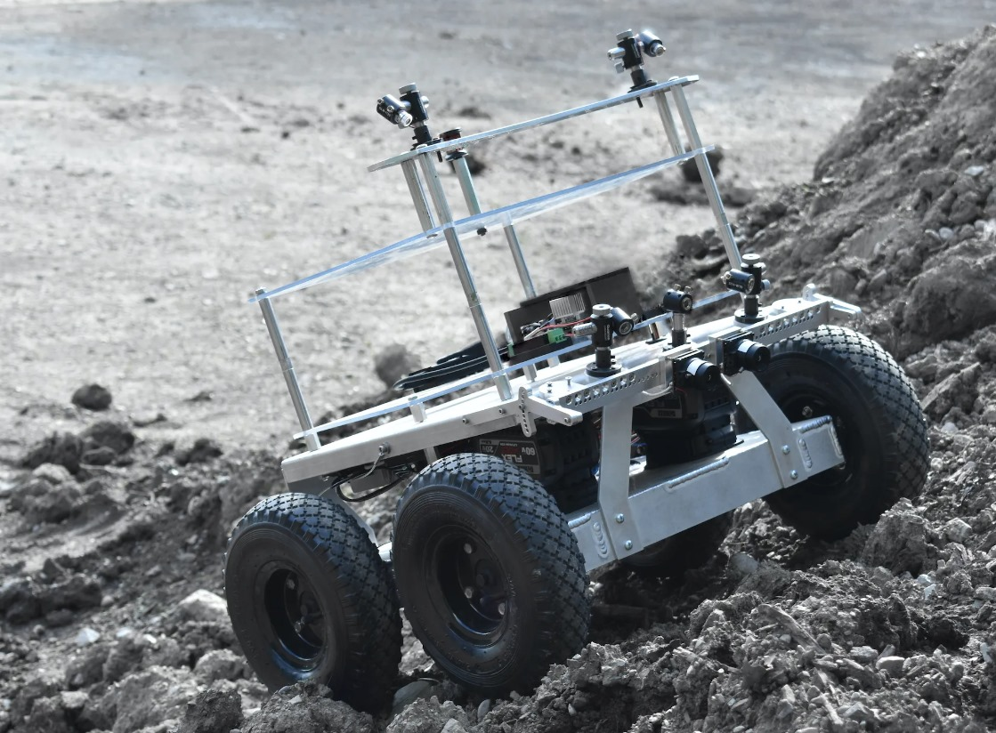
Introduction
What is Morphobot?
Morphobot is a hybrid rover designed to operate both on land and in the air.
Utilize Raspberry Pi for ground control and Arduino for aerial control.
Incorporate RF and Bluetooth for versatile, remote operations.

Slide 4
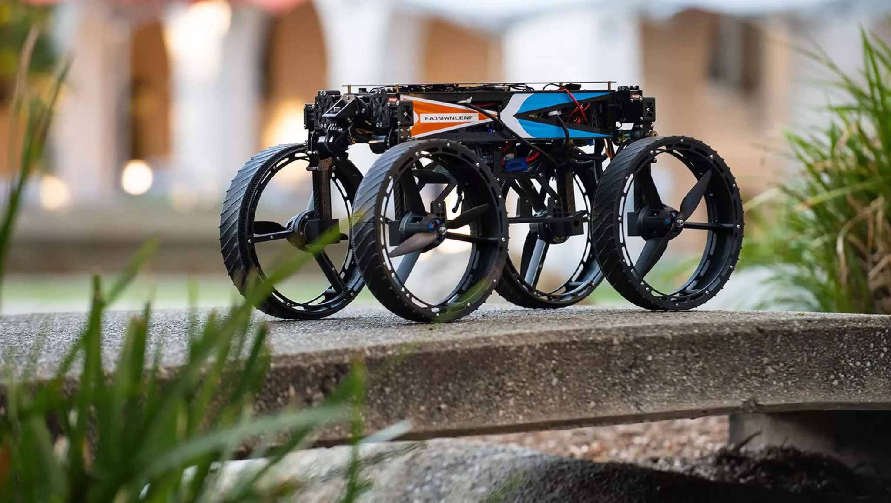
Problem Statement
Traditional rovers can't always get around in tough places because they only move on the ground. Morphobot fixes this problem by being able to drive and fly, which helps it move easily in many different areas. It's controlled remotely, making it really useful for exploring all kinds of environments.

Slide 5
Our Goal
Main Objective: To develop Morphobot into a versatile, dual-mode rover that excels in navigating diverse environments.
Key Features:
Enable seamless transition between driving and flying to handle various terrains.
Advanced control systems using Raspberry Pi and Arduino for reliable operations on land and in air.
Equip Morphobot with RF and Bluetooth communication for robust, remote control capabilities.
Plan
Test
Design
Launch

Slide 6
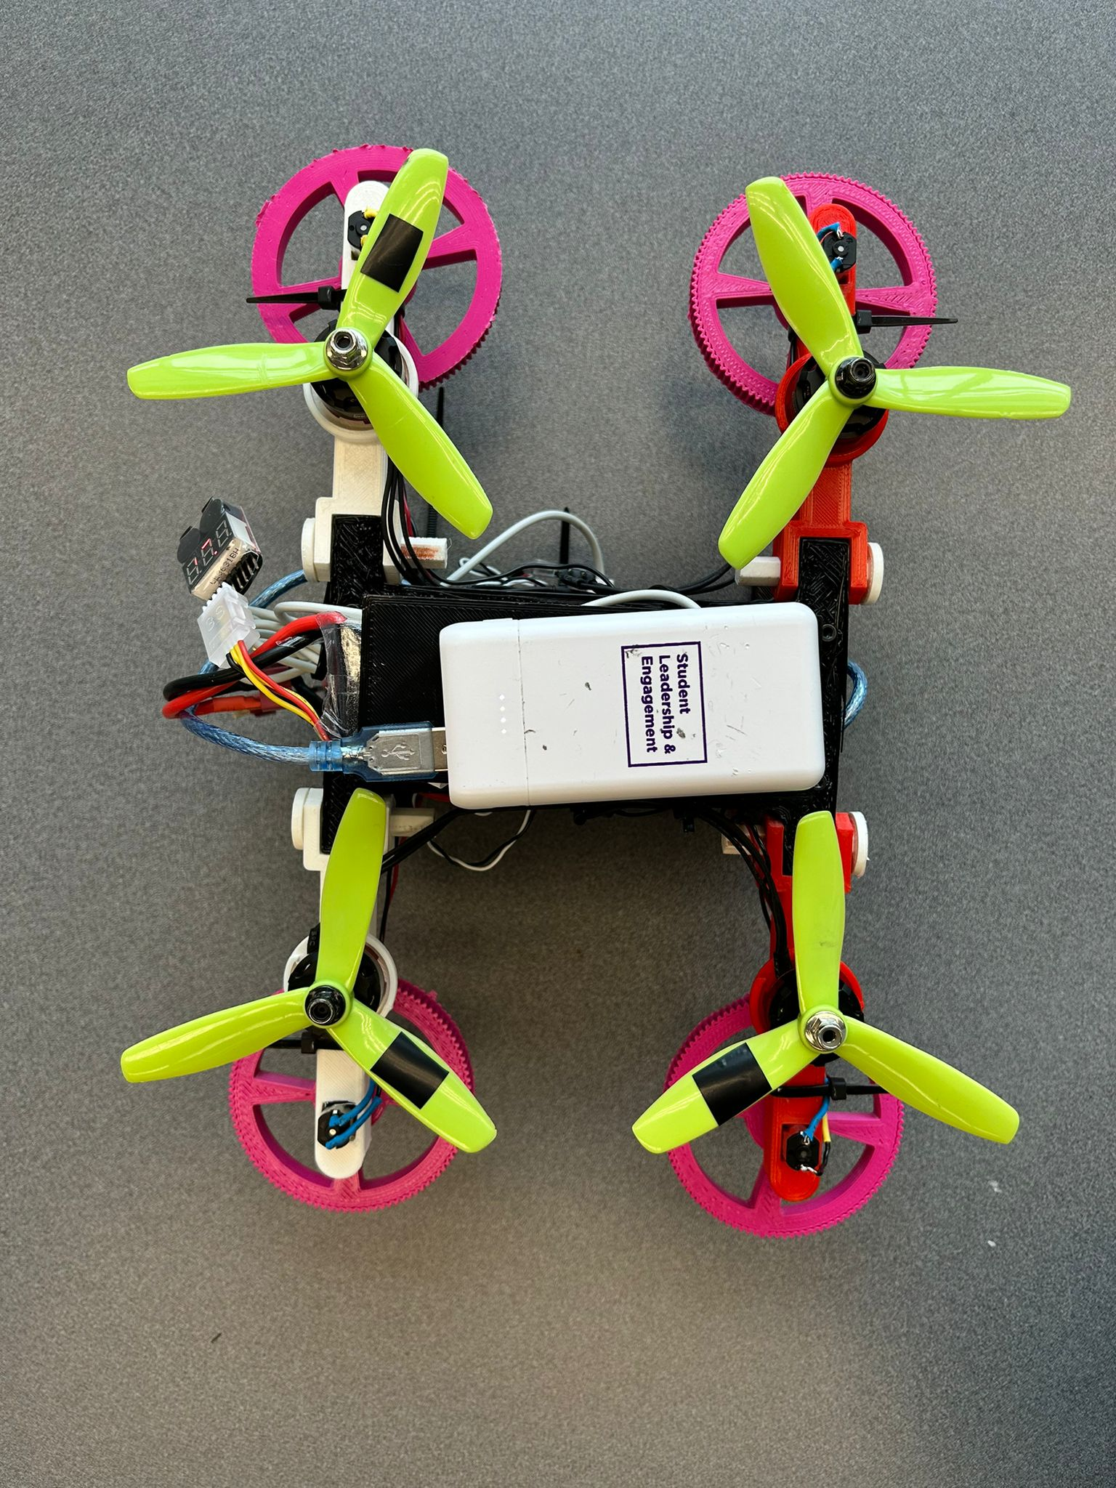
Our Solution
Morphobot features hybrid functionality, allowing it to efficiently switch between driving and flying with precise control managed by Raspberry Pi and Arduino, and is remotely controlled via RF and Bluetooth, making it highly adaptable for various environments.

Slide 7
Components used
Microcontroller used: Arduino & Raspberry pi
Lipo Battery Voltage checker: This voltage checker and alarm monitor the Lipo battery's state, alerting us if the voltage drops too low.
LiPo Battery
The L298N Motor Drive Controllers: They are crucial for steering MorphoBot, as they manage two motors at once for smooth and precise movements. They easily work with Arduino, simplifying our rover's setup.

Slide 8
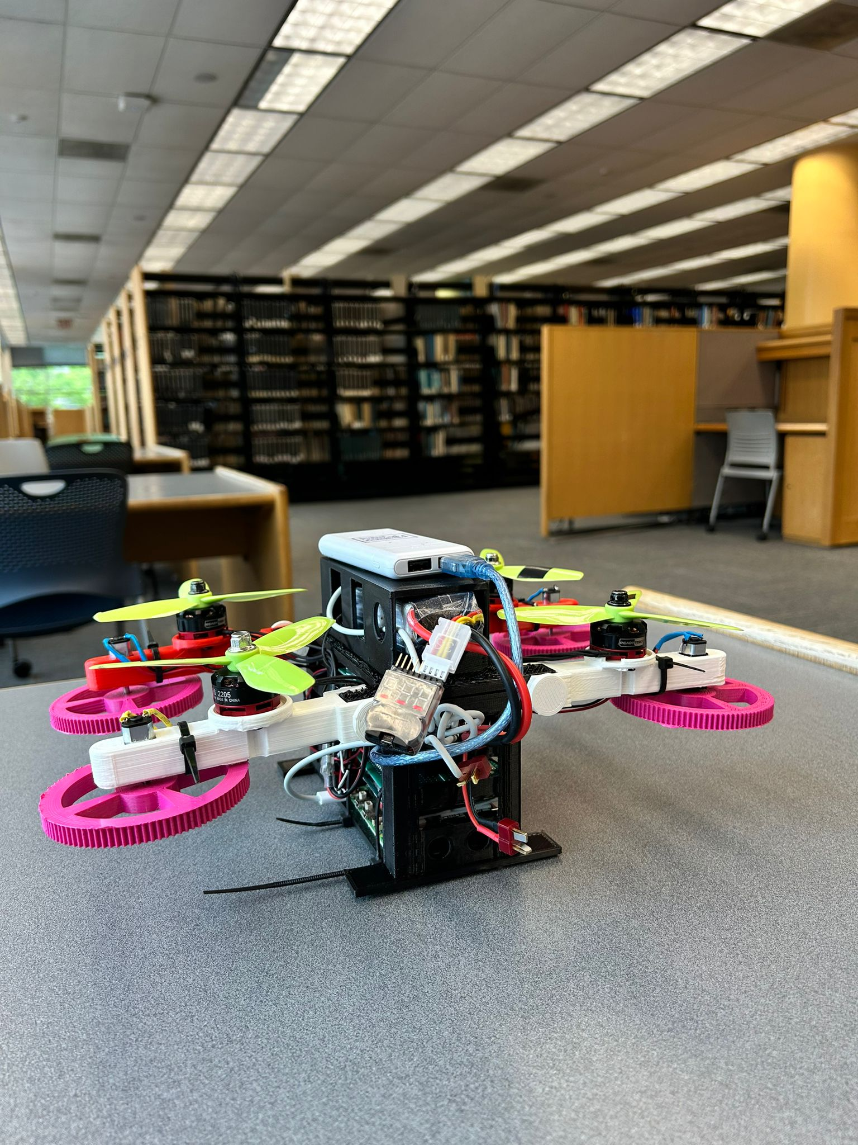
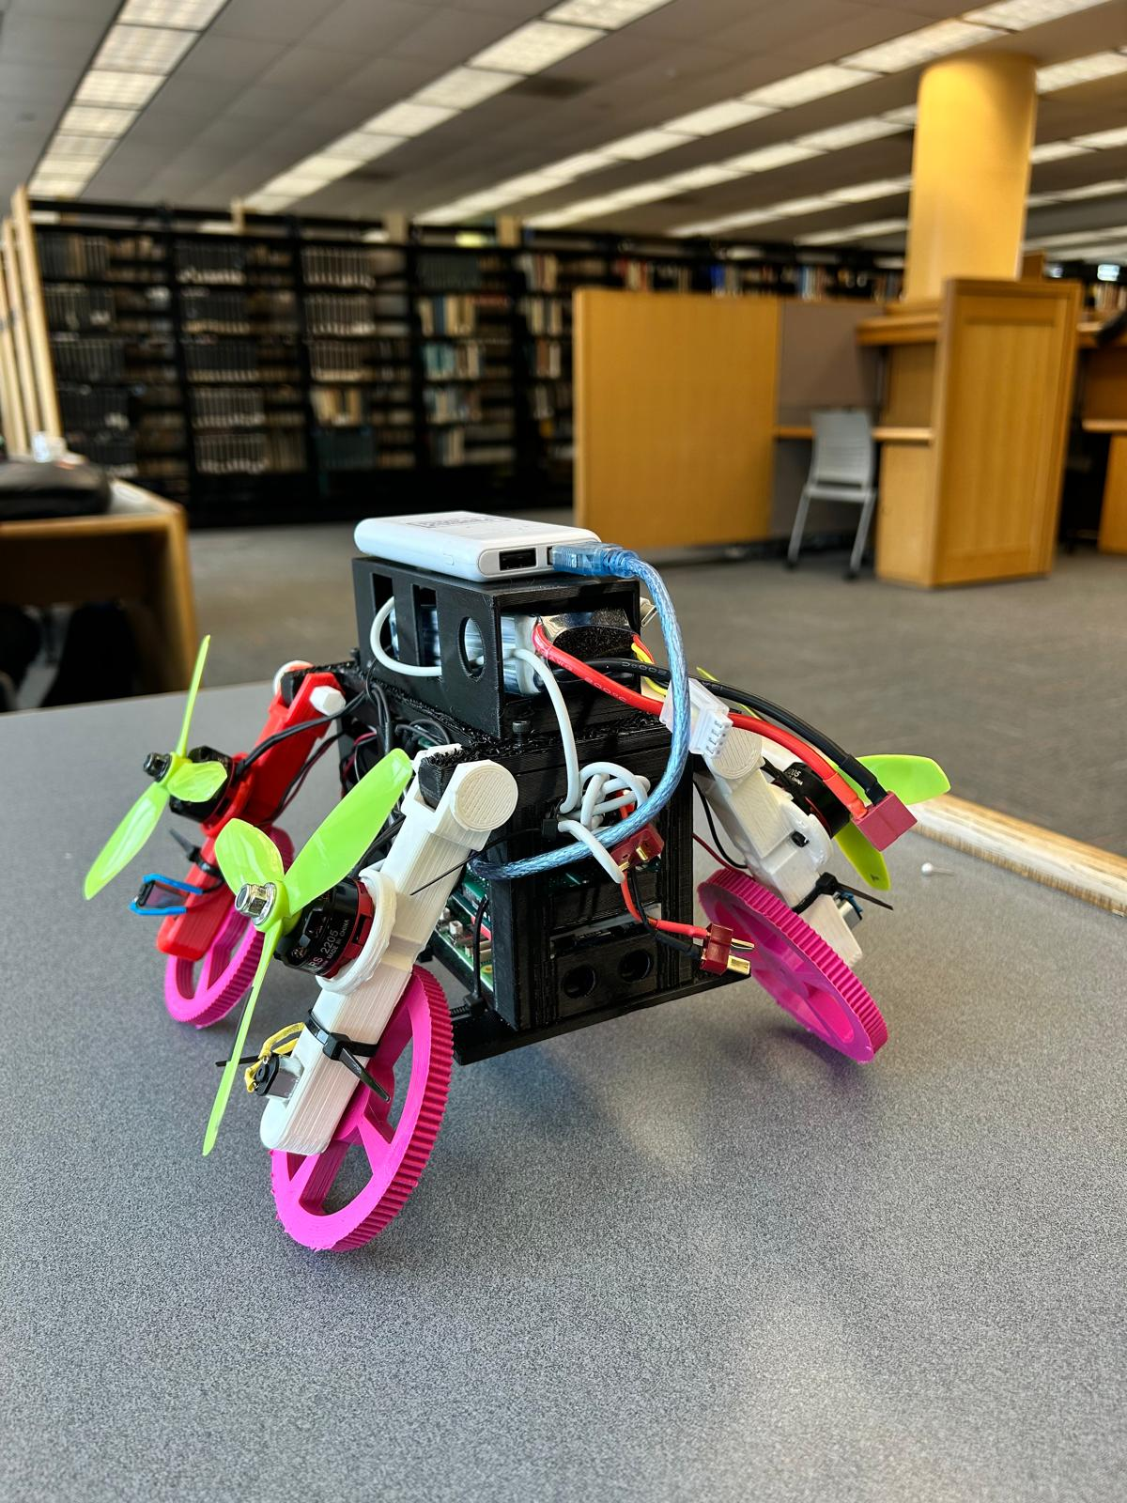
Our Morphobot

Slide 9
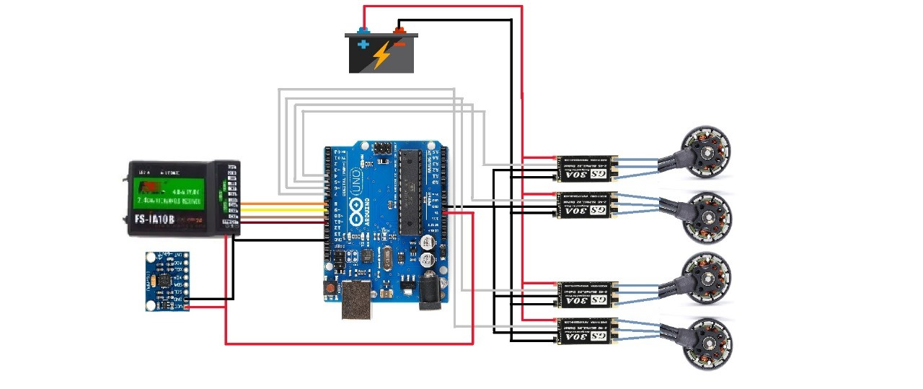
Schematic of Morphobot

Slide 10
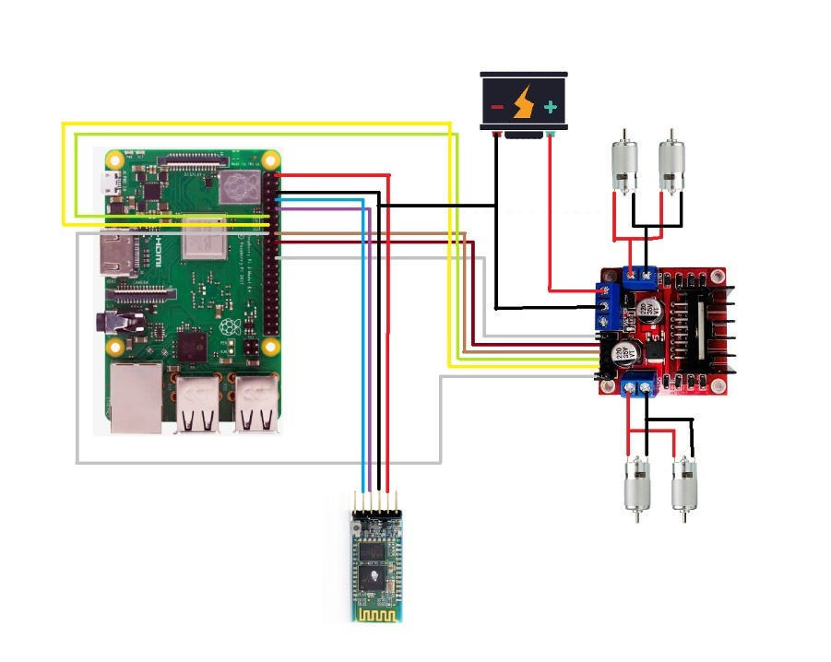

Slide 11
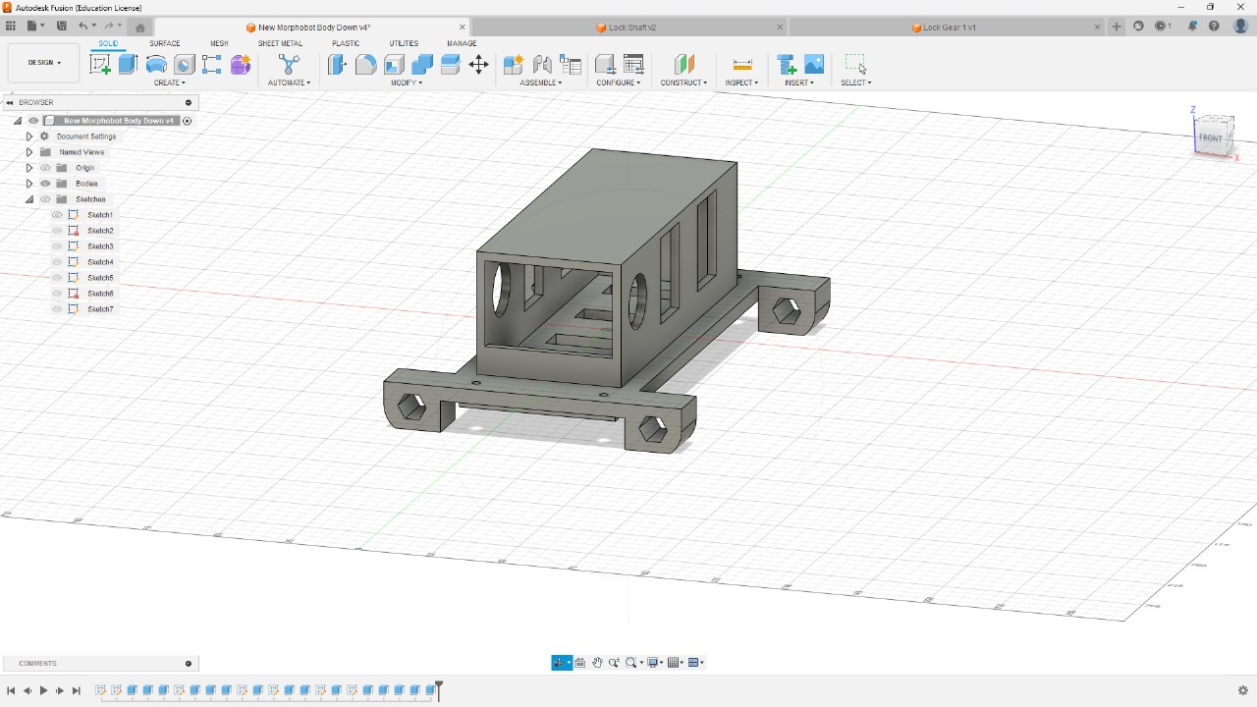
Mechanical Design

Slide 12
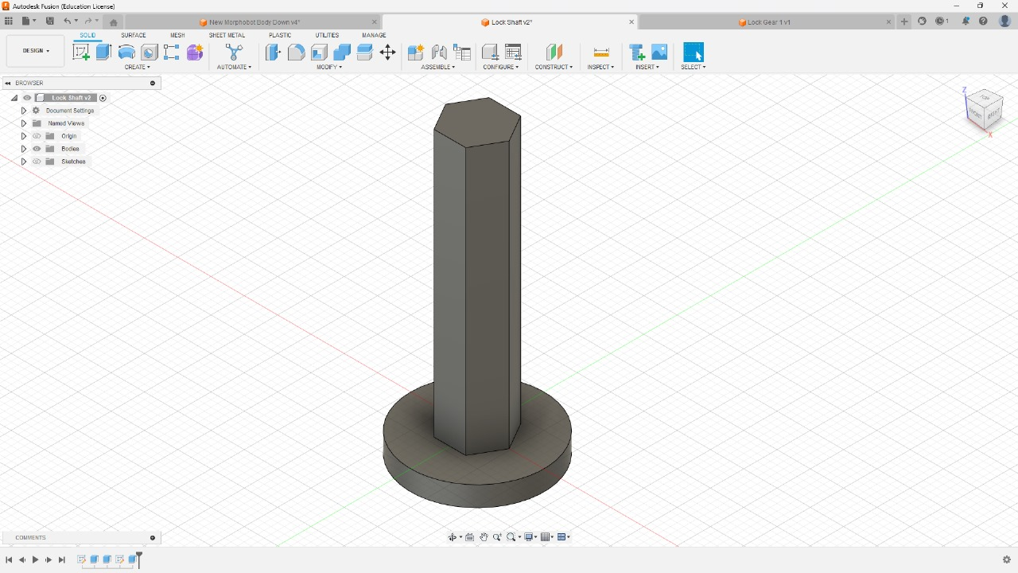

Slide 13
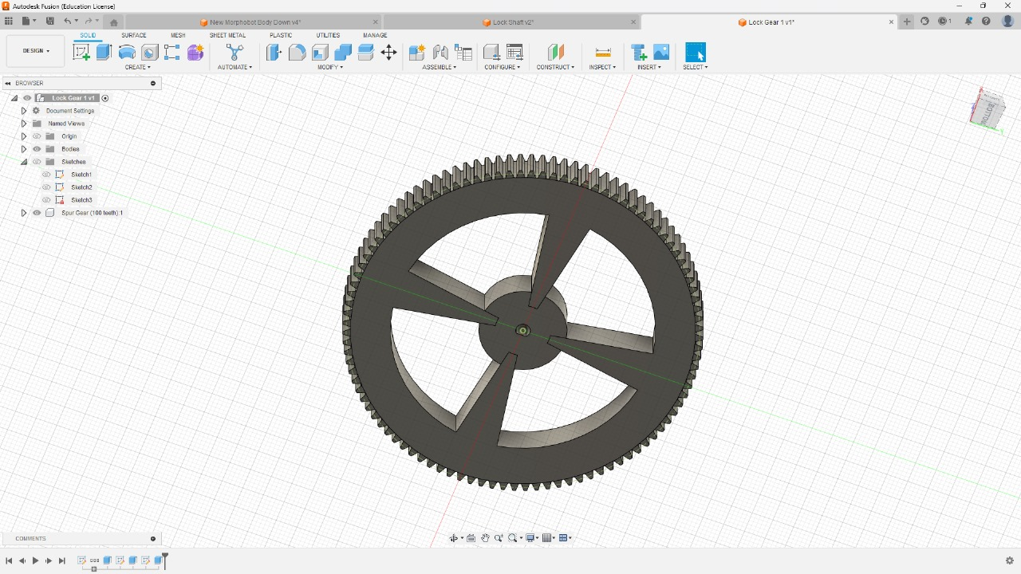

Slide 14
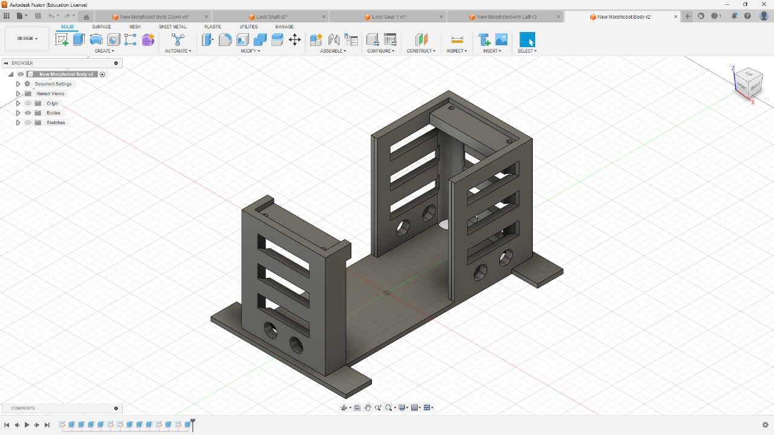

Slide 15
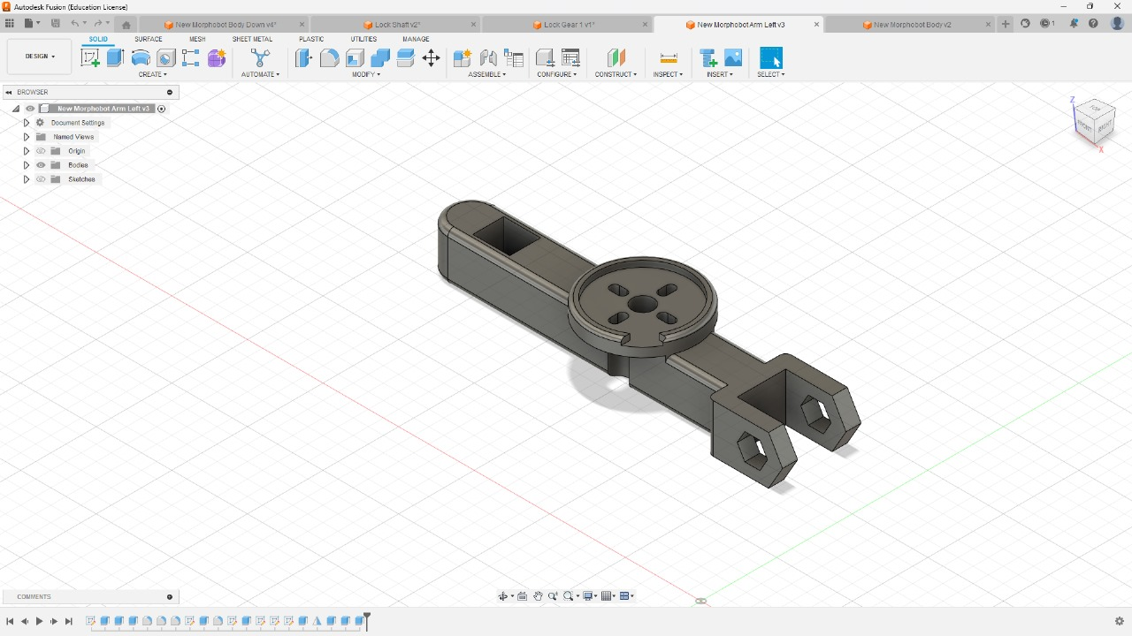

Slide 16

Video

Slide 17
Cost Breakdown
Product | Cost
Lipo Battery Voltage Checker | $5.49
Lipo Charger | $39.99
LiPo Battery | $11.99
Arduino | $27.60
Motor Drive Controller | $7.98
Raspberry Pi | $35
Total | $128.05

Slide 18
THANK YOU!
QUESTIONS?

